Slide 1
DS-306 Data Warehousing and Business Intelligence
Lecture 1: Introduction
Dr. Khurram Shahzad

Slide 2
Agenda
Introduction
Course Material
Course Evaluation
Course Contents

Slide 3
Course Material (Books)
A. Vaisman, E. Zimanyi. Data Warehouse Systems: Design and Implementation. Springer
Data Warehousing Fundamentals. A Comprehensive Guide for IT Professionals. by Paulraj Ponniah.

Slide 4
Grading Scheme (most likely)
Assignments
Quizes
Mid Term (35 marks)
Final Term (40 marks)

Slide 5

Job Description Example

Slide 6
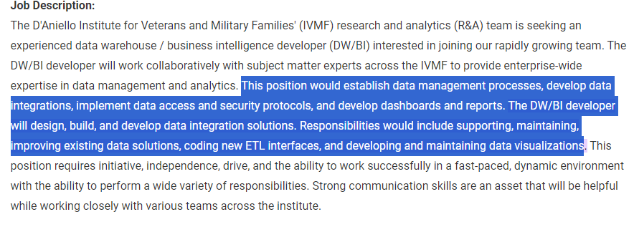
Job Description Example

Slide 7
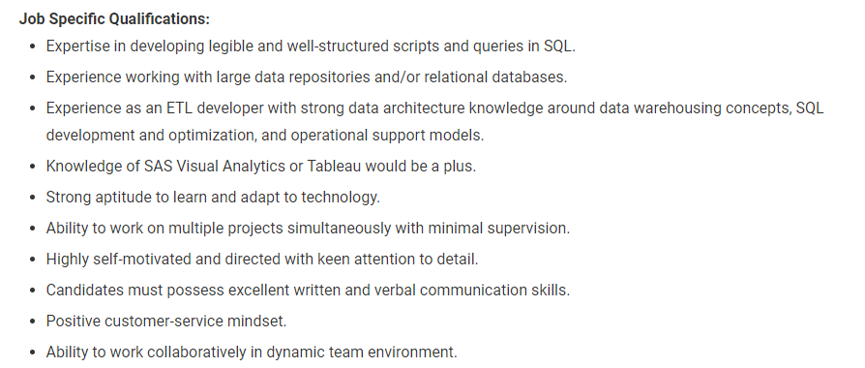
Job Description Example

Slide 8
Operational Sources (OLTP’s)
Operational computer systems did provide information to run day-to-day operations, and answer’s daily questions, but…
Also, called online transactional processing system (OLTP)
Data is read or manipulated with each transaction
Transactions/queries are simple, and easy to write
Usually for middle management
Examples
  Sales systems
  Hotel reservation systems
  Campus management system
  HRM Applications etc.

Slide 9
Basics: Database concepts
A database is a shared collection of logically related data, and a description of that data, designed to meet the information needs and support the activities of an organization.
A database is deployed on a database management system (DBMS), which is a software system used to define, create, manipulate, and administer a database.

Slide 10
Basics: Database concepts
Typically, DB design is a complex undertaking having four phases
Requirements specification
Conceptual design (ERD)
  Top-down design (difficult and expensive for large DBs and inexperienced developers)
  Bottom-up design (schema for each group of users and integrated later)
Logical design (relational model)
Physical design

Slide 11
Conceptual DB design
Entity-relationship (ER) model is one of the most often used conceptual design
Entity types are used to represent a set of real-world objects of interest
  Employee, order, customer
  An object belonging to an entity type is called entity or instance
  The set of instances of an entity type is called its population
Entities have attributes

Slide 12
Conceptual DB design
Entities have attributes
There are several types of attributes
  Mono-valued attribute
  Multivalued attribute
  Simple (non-decomposed)
  Composite
  Derived
  Non-derived

Slide 13
Conceptual DB design
Relationship types are used to represent these associations between objects
An association between objects of a relationship type is called a relationship or an instance.
Each entity has associated with it a pair of cardinalities that describe minimum and maximum number of items
An entity role is Optional or Mandatory depending on the minimum cardinality is 0 or 1

Slide 14
Conceptual DB design
Based on optional or mandatory, a role is said to be monovalued or multivalued
In case same entity type is related more than once in a relationship type, the relationship type is called recursive

Slide 15
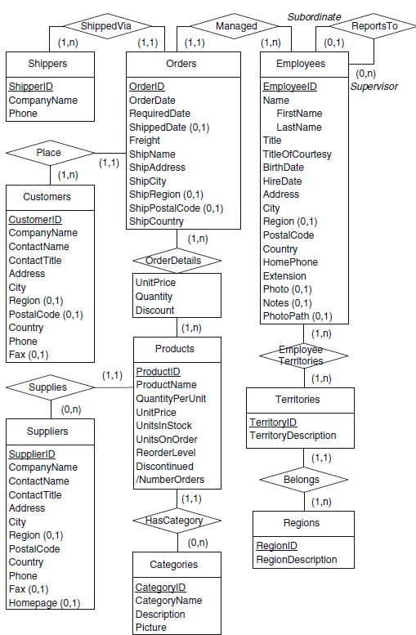

ERD Example

Slide 16
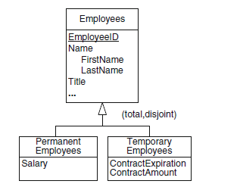
Conceptual DB design
The generalization (or is-a) relationship captures the complexity of conceptualizing real world
  Supertype and subtype means both types represent the same concept at different level of detail

Slide 17
Logical DB design
The relational model has a simple data structure, a relation (or table) composed of one or several attributes (or columns).
Properties of a relation
A relational schema describes the structure of a set of relations.

Slide 18
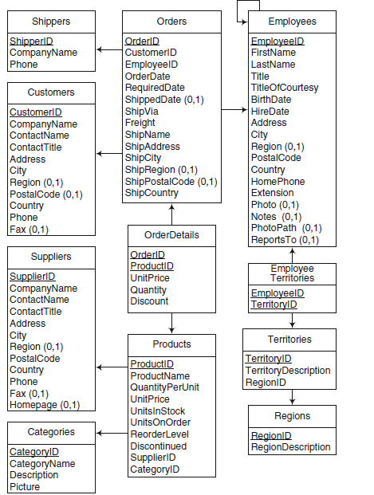

Slide 19
Conceptual vs Logical

Slide 20
Logical DB design
Keys of
  Primary key
  Foreign key
Referential integrity

Slide 21
DW and BI

Slide 22
Business Intelligence
Business intelligence “a set of techniques and tools for the acquisition and transformation of raw data into meaningful and useful information for business analysis and purposes”
Business intelligence comprises a collection of methodologies, processes, architectures, and technologies that transform raw data into meaningful and useful information for decision making.

Slide 23
Business Intelligence
Business intelligence and decision-support systems provide assistance to managers at various organizational levels for analyzing strategic information.
BI & DSS systems collect vast amounts of data and reduce them to a form that can be used to analyze organizational behavior.

Slide 24
Business Intelligence
This data transformation comprises a set of tasks that take the data from sources, through extraction, transformation, integration, and cleansing processes, store the data in a common repository called a data warehouse

Slide 25
Business Intelligence
From the early days of data warehousing, the typical mechanism for those tasks has been Online Analytical Processing (OLAP).
Data mining tools have also been used in 1990s to infer and extract interesting knowledge hidden in data warehouse
The new paradigm is generally called data analytics

Slide 26
Path to BI consultant
Software Engineer (DW/BI Developer)
  Analyze DW/decision support business requirements.
  Develop scripts using PL/SQL to perform DML functions
  Dashboard and reports development

Slide 27
Path to BI consultant
Senior SE (DW/BI Administrator)
  Database design, indexing, performance monitoring, and object creation such as cursors, triggers, stored procedures
  DW Management, DW creation, taking backups and restoration.
  Process of Data Migration from modules
  Develop routines for loading data in DWH.
  Schedule database jobs for the extraction of data.

Slide 28
Path to BI consultant
Principal DW Architect
  ETL Process Flow Design & Development
  ETL Mappings Design & Development
  Data Migrations

Slide 29
Path to BI consultant
BI Manager
  Develop, prepare and execute strategies for BI processes
  Identify critical success factors and mitigate risk
  Data warehouse methodology, project planning,
  Modeling complex BI projects
  Setting and enforcing BI stands and architecture
BI Consultant

